Slide 1
VADA PAV BUSINESS ANALYSIS
BY
AKHILA V

Slide 2
OUTLINE AND PROBLEM STATEMENT
Akhil wants to open an Vada pav shop at Shivajinagar , Pune.
PROBLEM STATEMENT
Analyse and create a strategy to develop his business in same area.

Slide 3
DATA COLLECTION
Data is collected w.r.t
Taste , Quality, Hygiene , Ambience – @ Rate 5
Price
Home Delivery
Digital Payment

Slide 4

ANALYSE the COMPETITORS

Slide 5


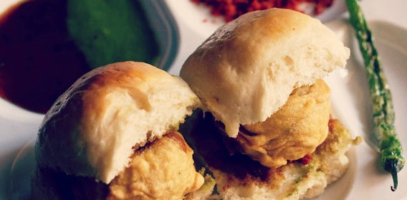
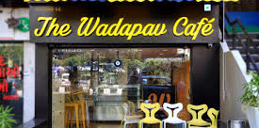
BUSINESS STRATEGIES @ VADA POINT
Easy to locate the place.
Quality, big size Vada, tasty, fresh , hot & crispy
Payment accepted in cash, UPI (Digital Payments)
Separate counters for take away services
Include CAFE [Other snacks, coffee/Tea] with Vada pav
Suitable for all type of visitors – Family, Friends, Couples, Business talks etc.
Good place to have a refreshment to sit and spend time with mates.

Slide 6


BUSINESS STRATEGIES ONLINE
Take online orders and deliver correctly.
Promote Online offers to improve business.
Accept digital payments.
Keep up customer trust.
Customer feedback is valuable.

Slide 7
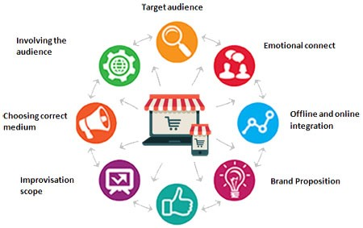
WHY CHOOSE VADA POINT??
ONE MUST BE ALWAYS UNIQUE IN ORDER TO BE IRREPLACEABLE !!

Slide 8



Slide 9


